Slide 1

HTML

Slide 2
HTML
Stands for HyperText Markup Language.
Hypertext - "text with links in it.“
HTML is used to give websites structure.
You can think of HTML as the skeleton that gives every webpage structure.

Slide 3
Tags nearly always come in pairs: an opening tag and a closing tag.
You can think of tags as being like parentheses: whenever you open one, you should close it. Tags also nest, so you should close them in the right order: the most recently opened tag should be the first one closed, like in the example below.
<html> </html>
opening tag closing tag
<first tag>
<second tag>Some text!</second tag>
</first tag>

Slide 4
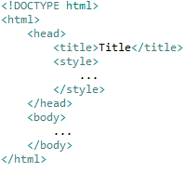
Always put <!DOCTYPE html> on the first line. This tells the browser what language it's reading (in this case, HTML5).
Everything in our HTML file will go between the opening <html> and closing </html> tags.
There are always two parts to an HTML file: the <head> and the <body>.

Slide 5
The body is where you put your content, such as text, images, and links. The content in the body is what will be visible on the actual page.
The body goes inside the <html>
right after the <head>
The head contains information about your HTML file, like its <title> . The title is what we see in the browser's title bar or page tab. For example the title of this page is "HTML Basics

Slide 6
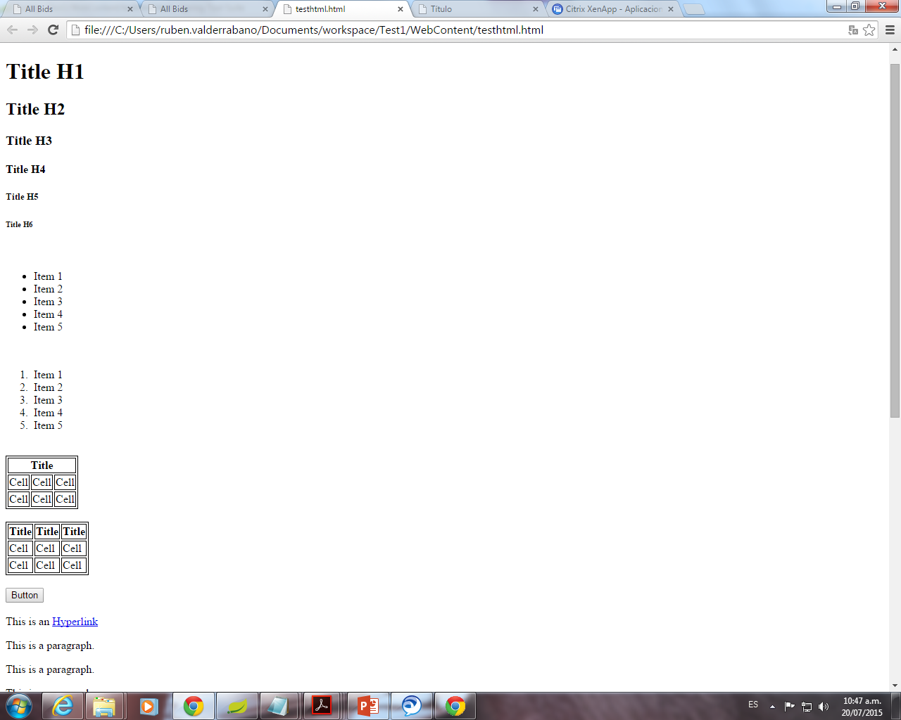
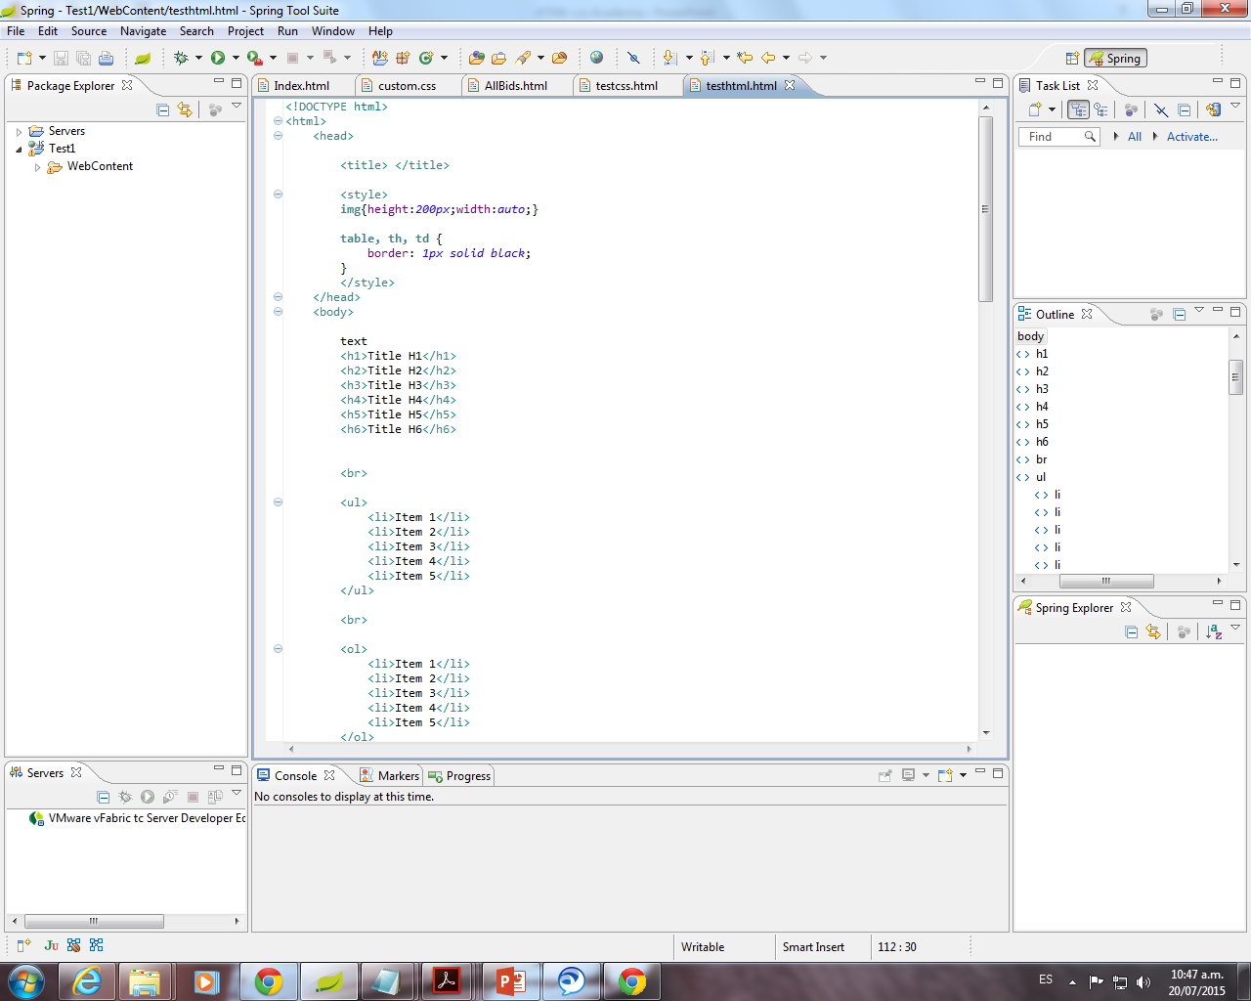
Headings
There are 6 different sizes.
From <h1> to <h6>

Slide 7
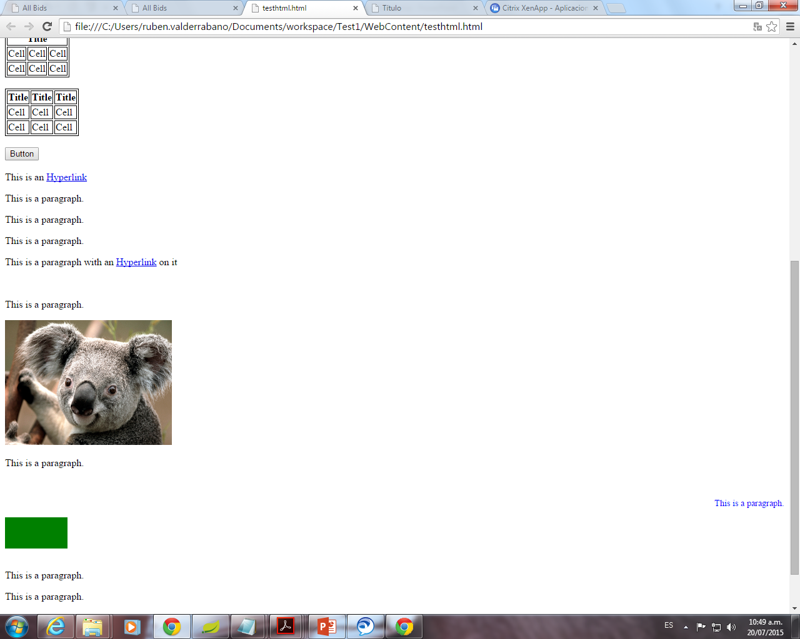
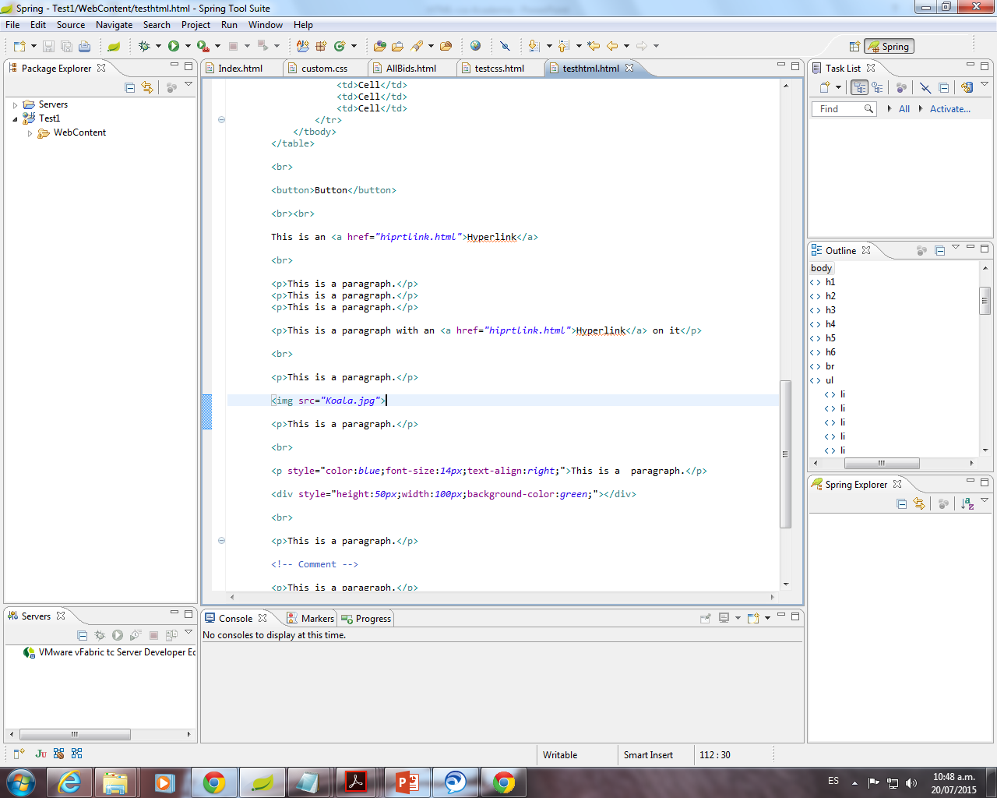
Paragraphs
The p element breaks text into paragraphs.
Any text that you surround with a <p></p> becomes a separate block

Slide 8
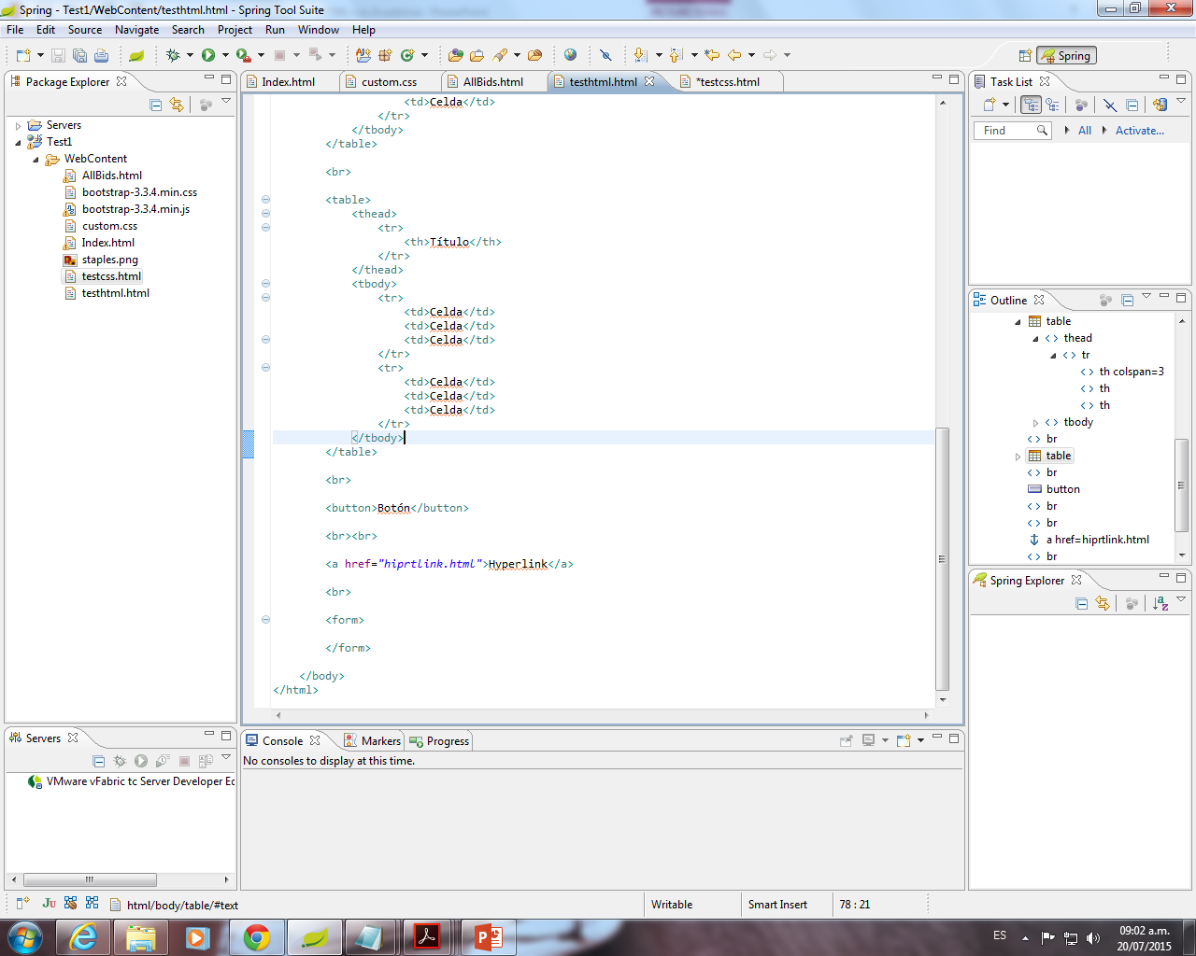
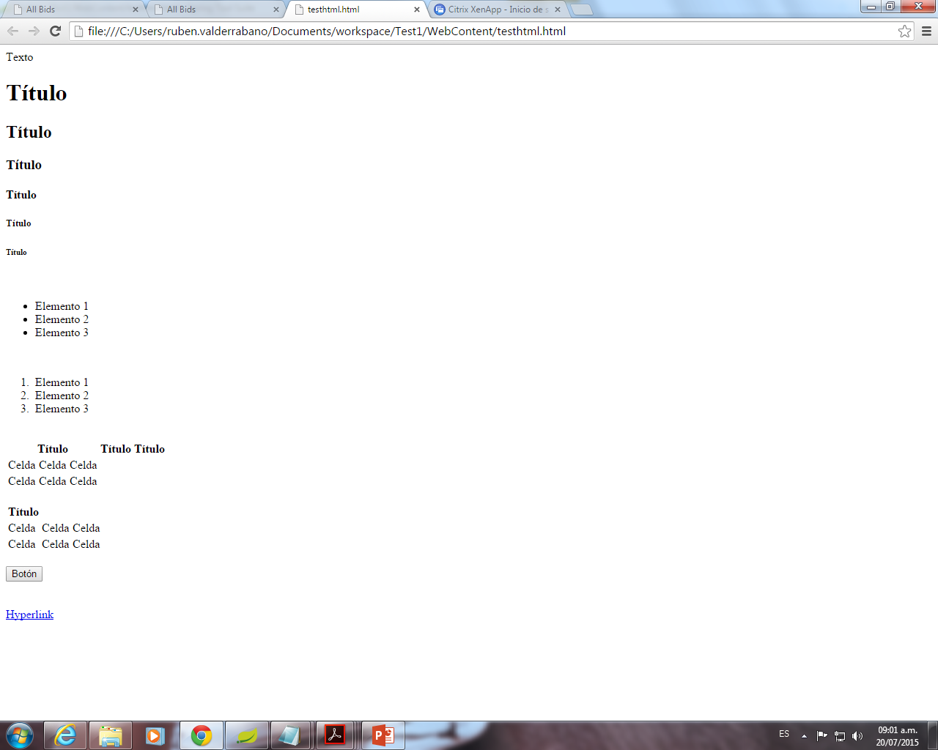


hyperlinks
Everything between these two tags <a></a> will work as a link.
The “href” value tells your link where you want it to go.

Slide 9

Images
<img src="url" >
This tag is different from the others.
There is no ending tag.
“src” tells the tag where to get the picture.

Slide 10
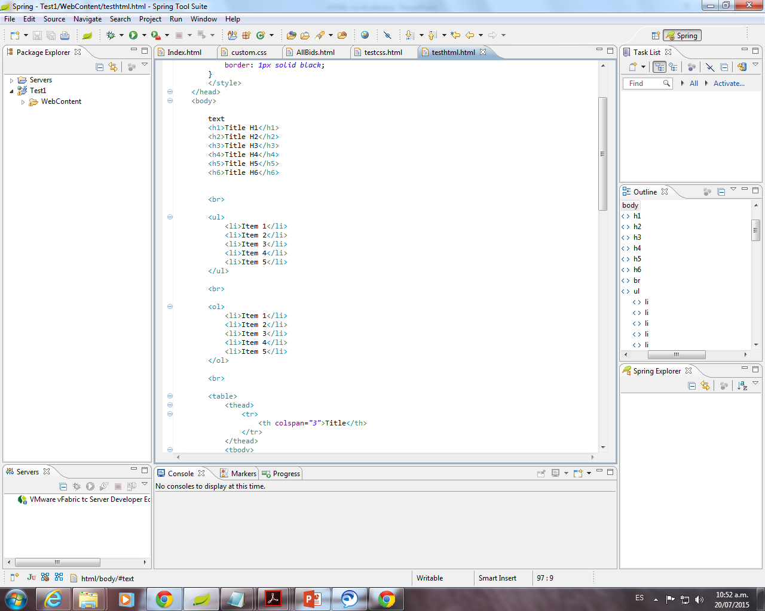
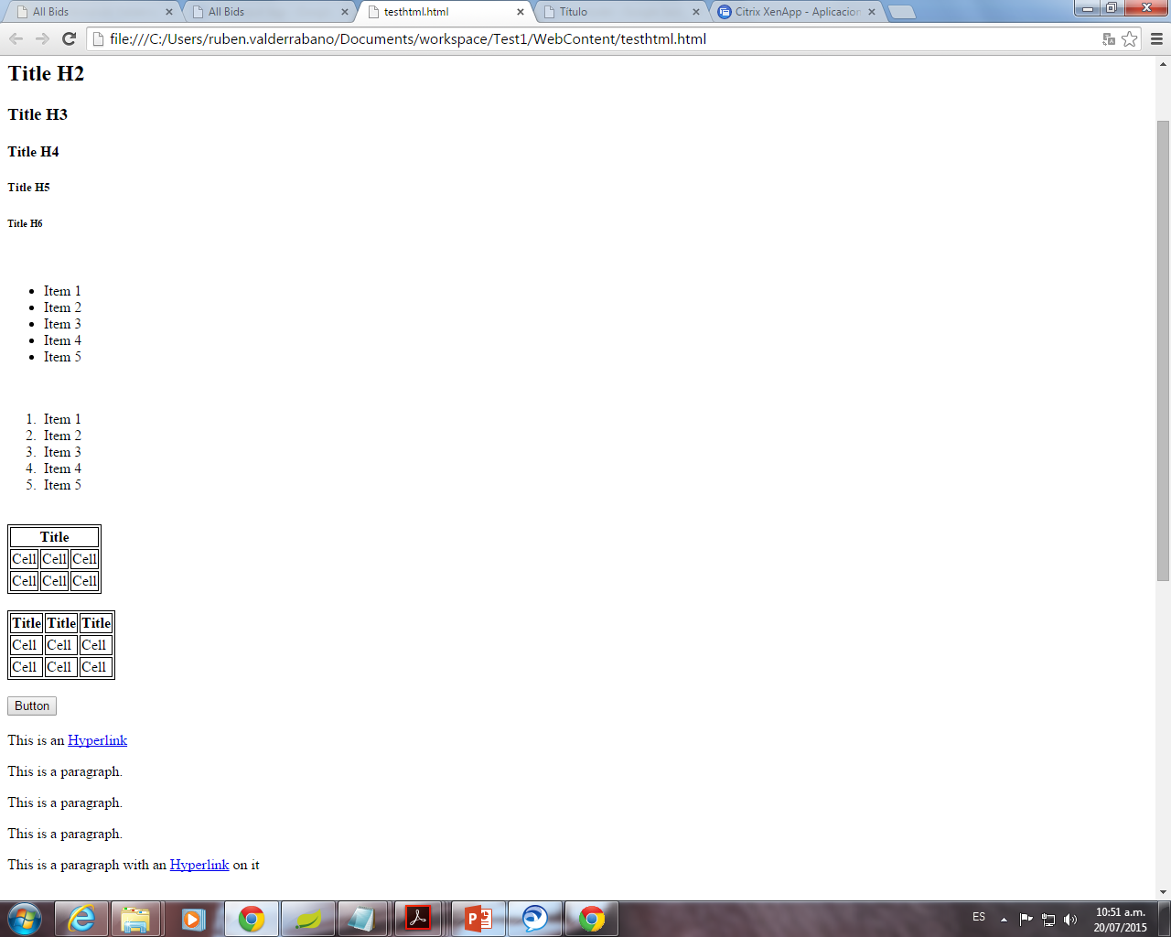
Lists
There are two kinds of lists: order list <ol> and unorder list <ul>.
An ordered list is simply a list that is numbered.
Unorder List
Order List

Slide 11
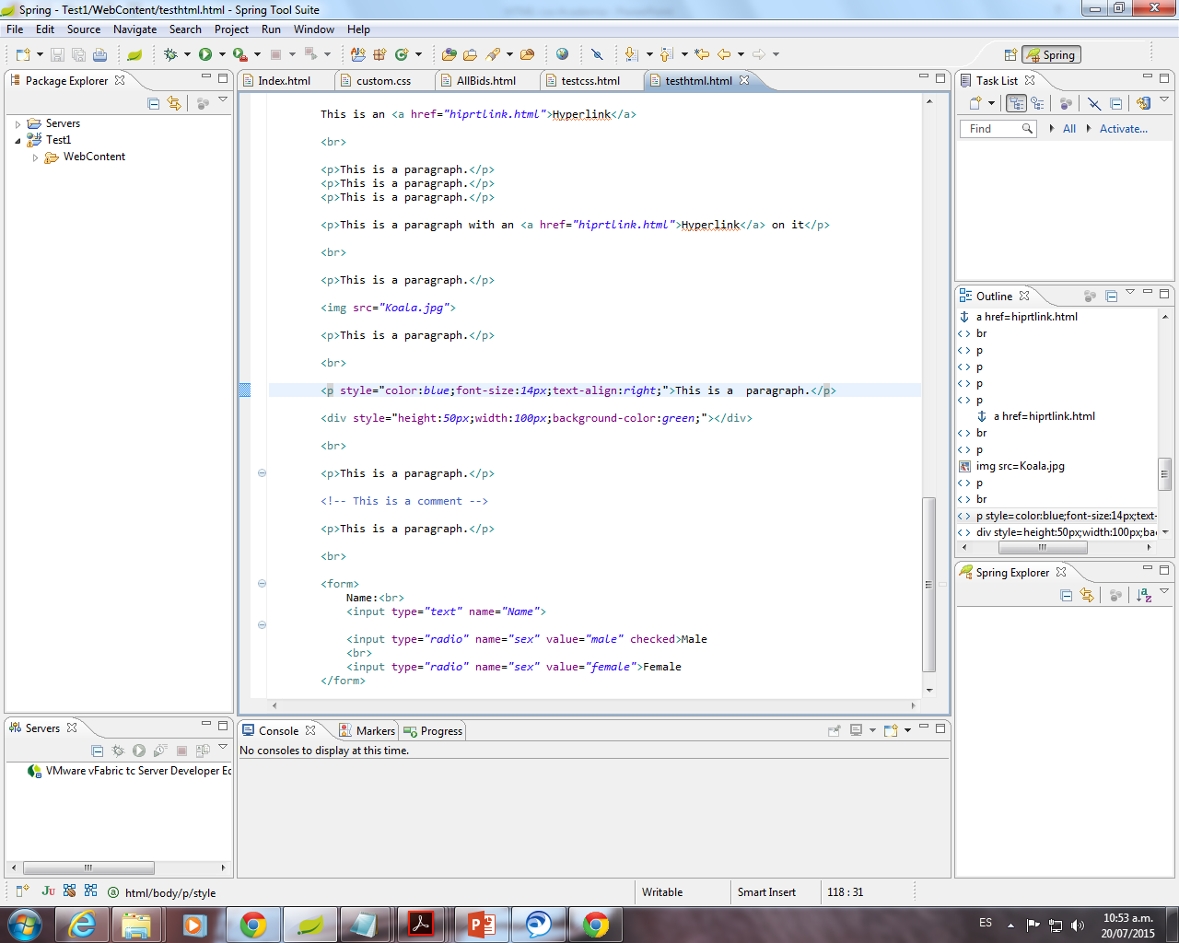
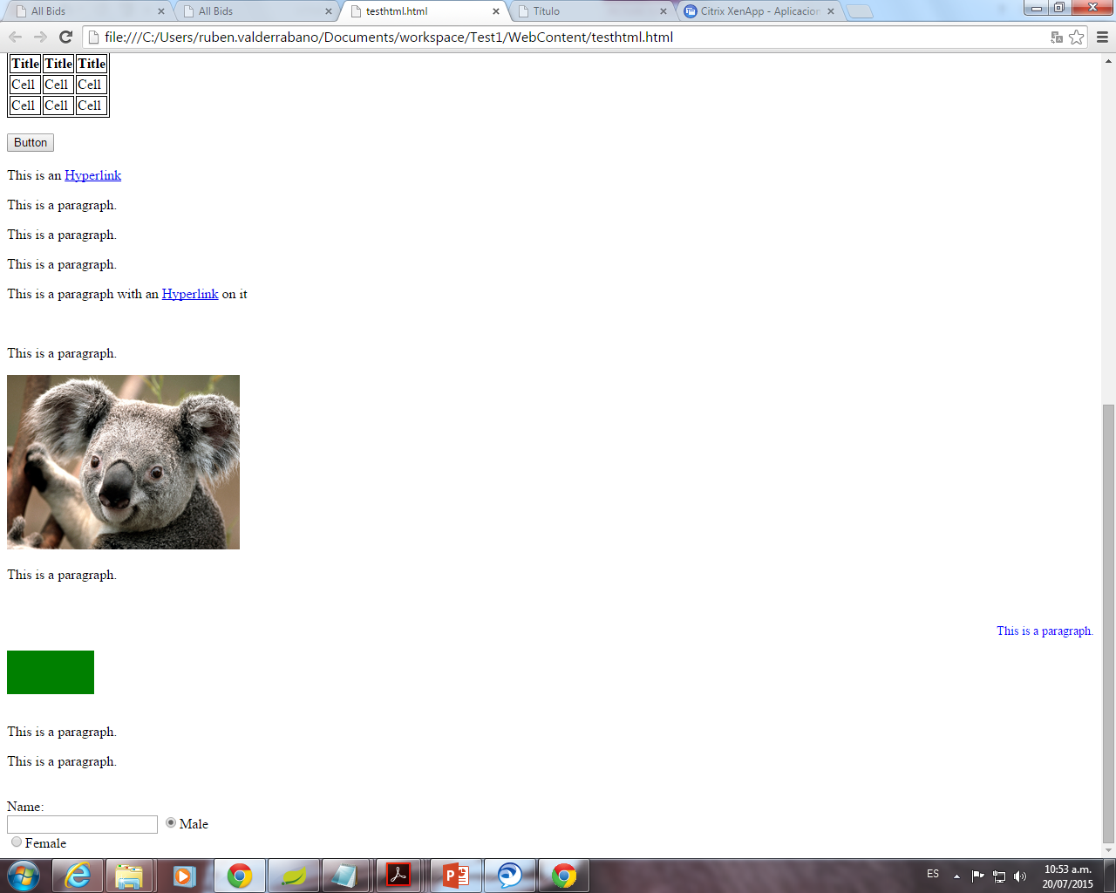
Comments
<!-- --> Comments are not displayed in the browser

Slide 12
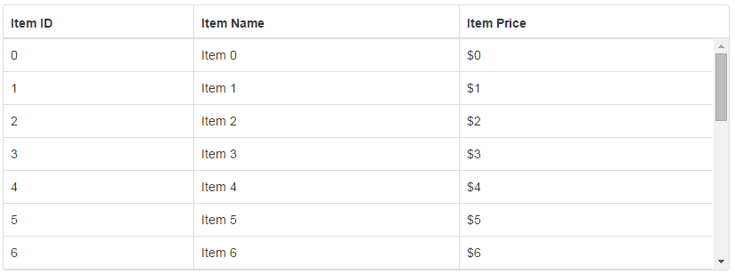
Tables
<table> tag.
A table is just a bunch of information arranged in rows and columns.

Slide 13
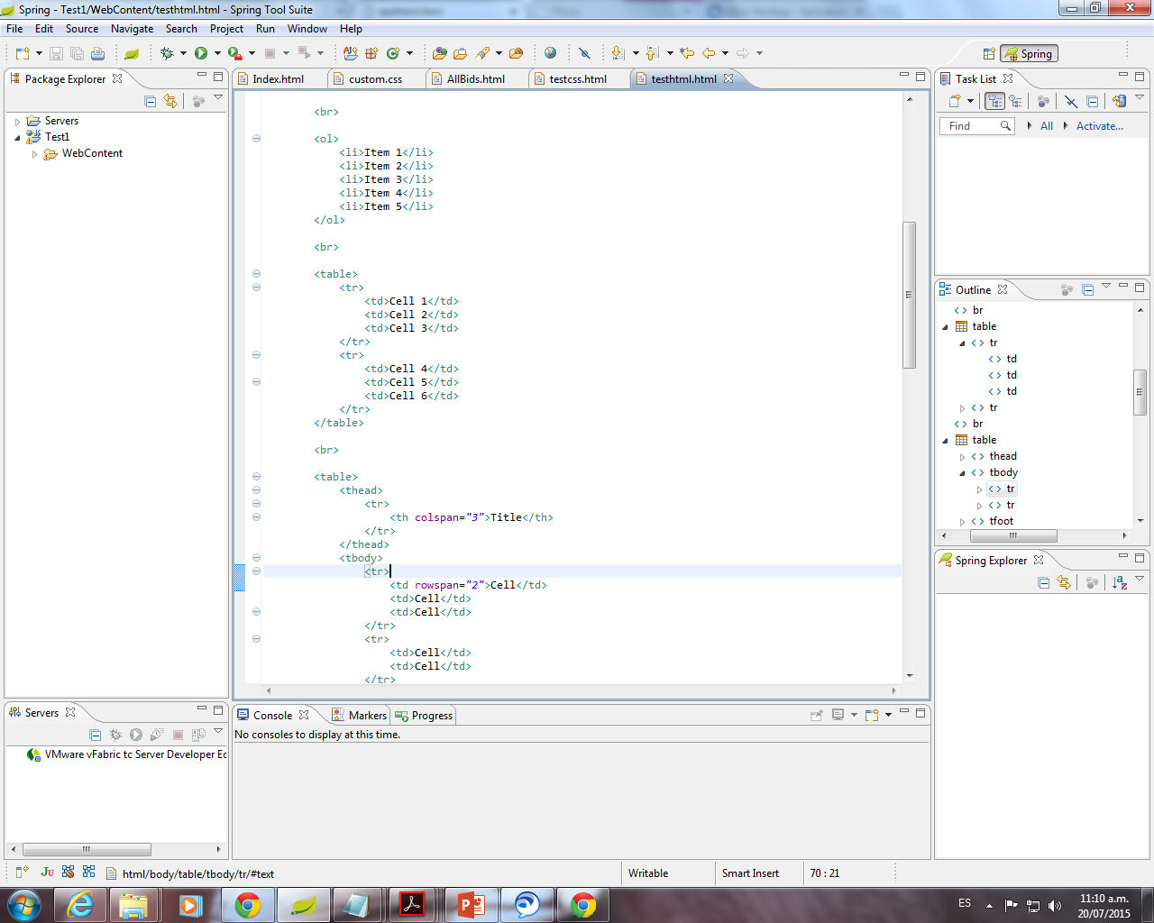
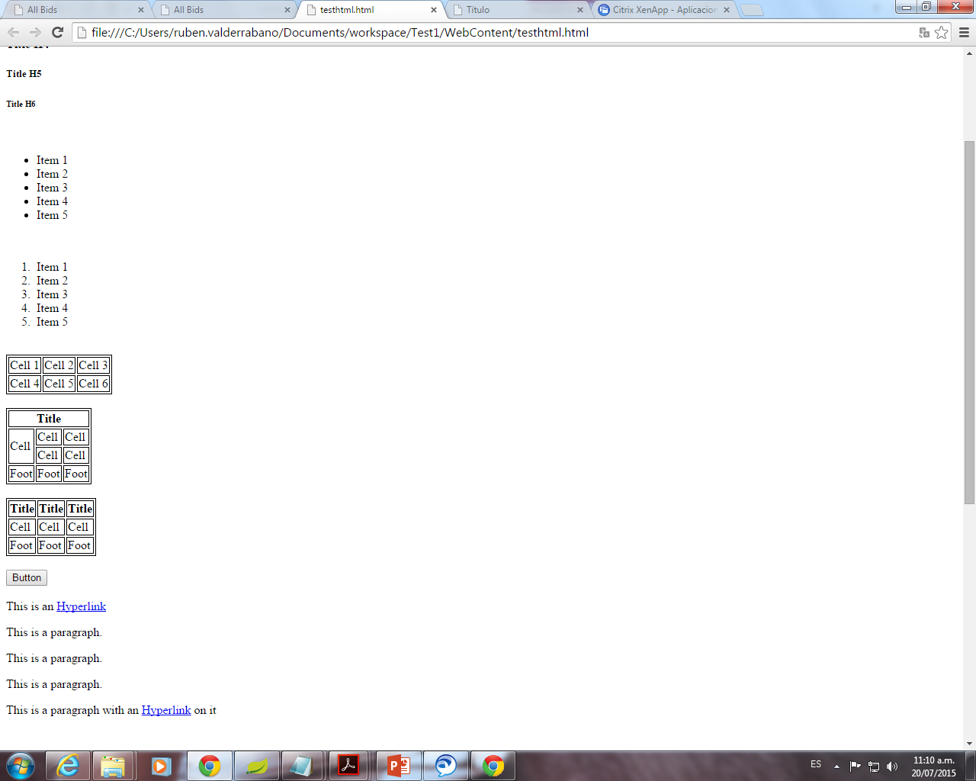
<tr> (table row) Tag to creates a table row.
<td> (table data) Tag to create cells.
You don't really create columns in tables: instead, you tell each row how many cells to have, and that determines your number of columns.

Slide 14
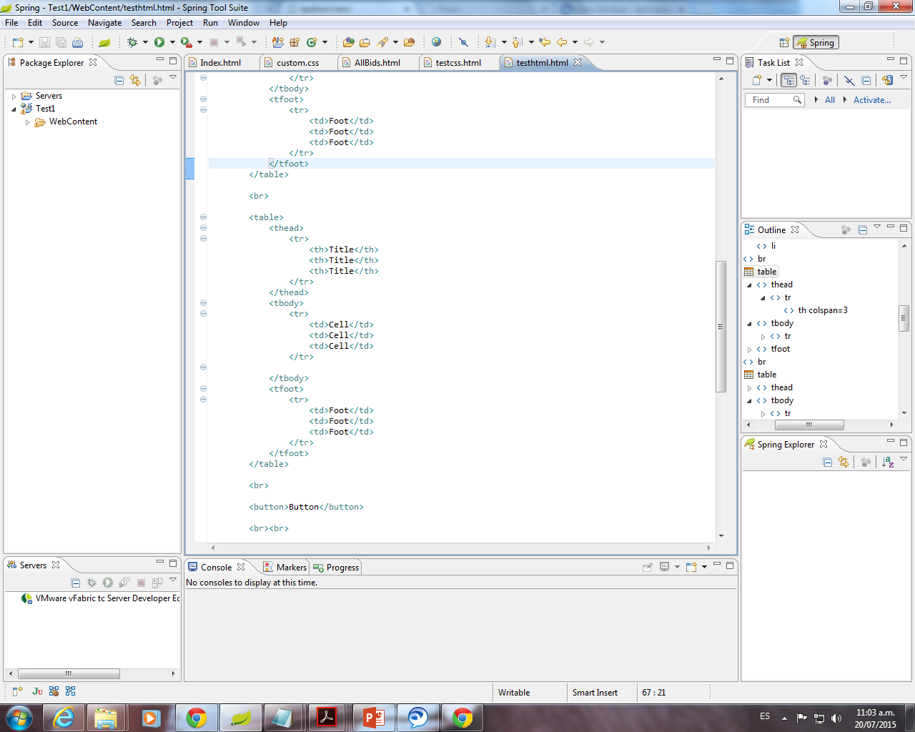
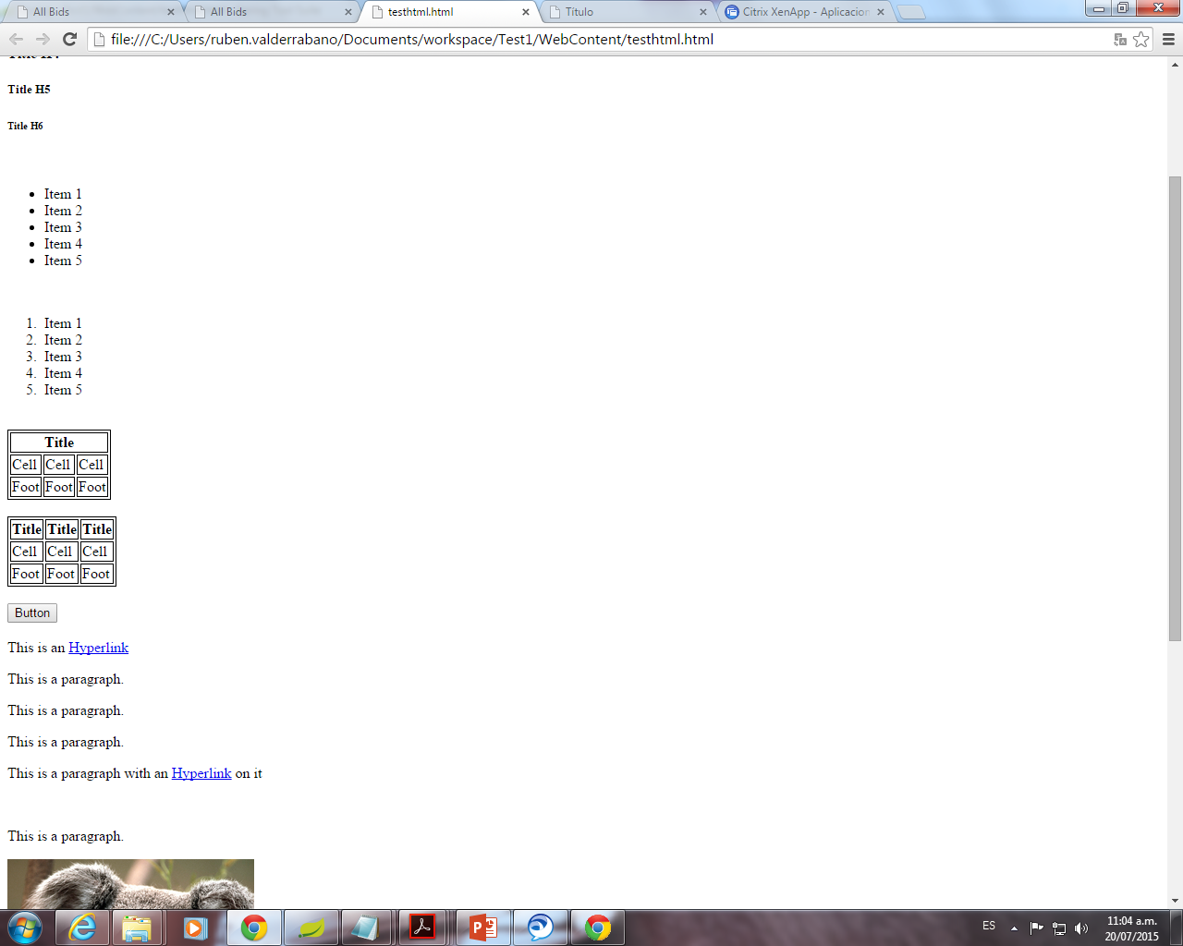
<th> (table heade) Tag to create header cells.
<thead> and <tbody> tags.
These go within the <table> tag and stand for table head and table body, respectively.

Slide 15
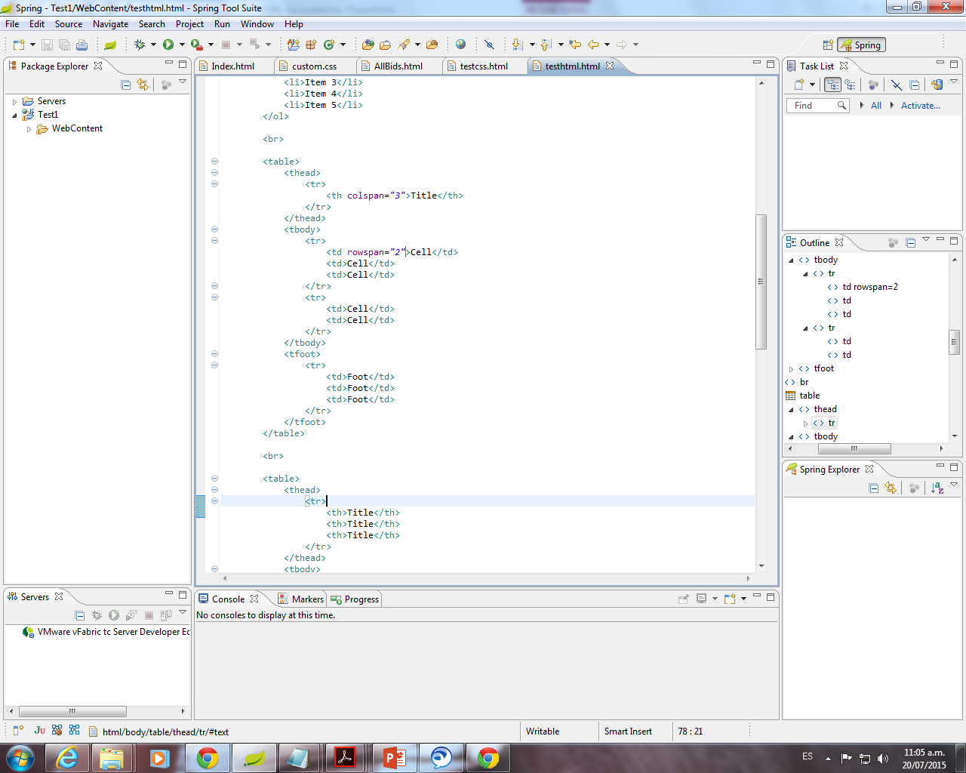
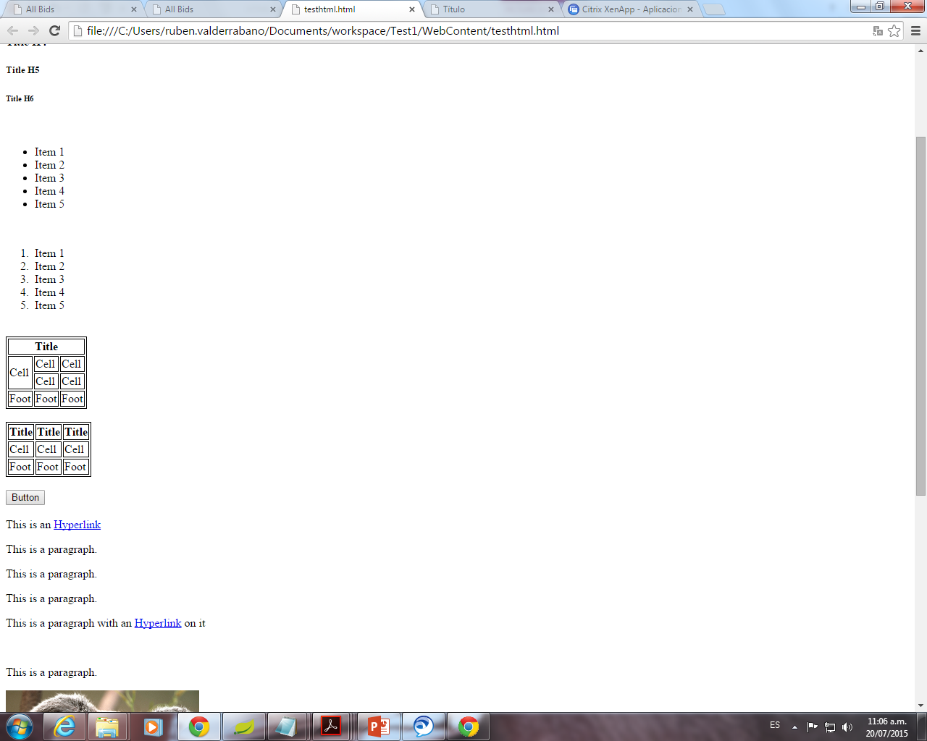
Colspan and rowspan attributes.
If we want a table cell to take up the space of 3 columns instead of 1, we can set the colspan attribute to 3.
If we want a table cell to take up the space of 2 rows instead of 1, we can set the rowspan attribute to 2.

Slide 16
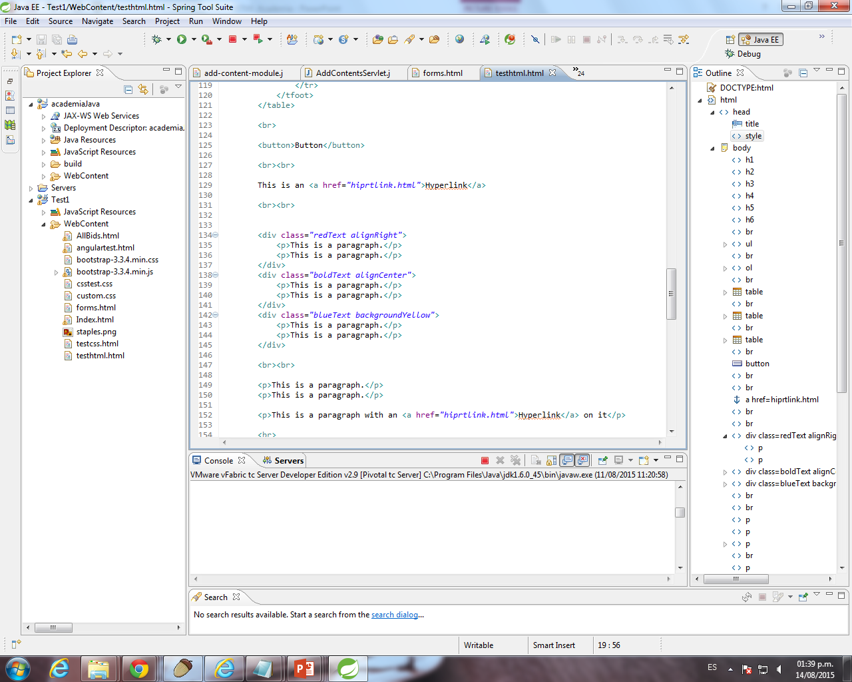
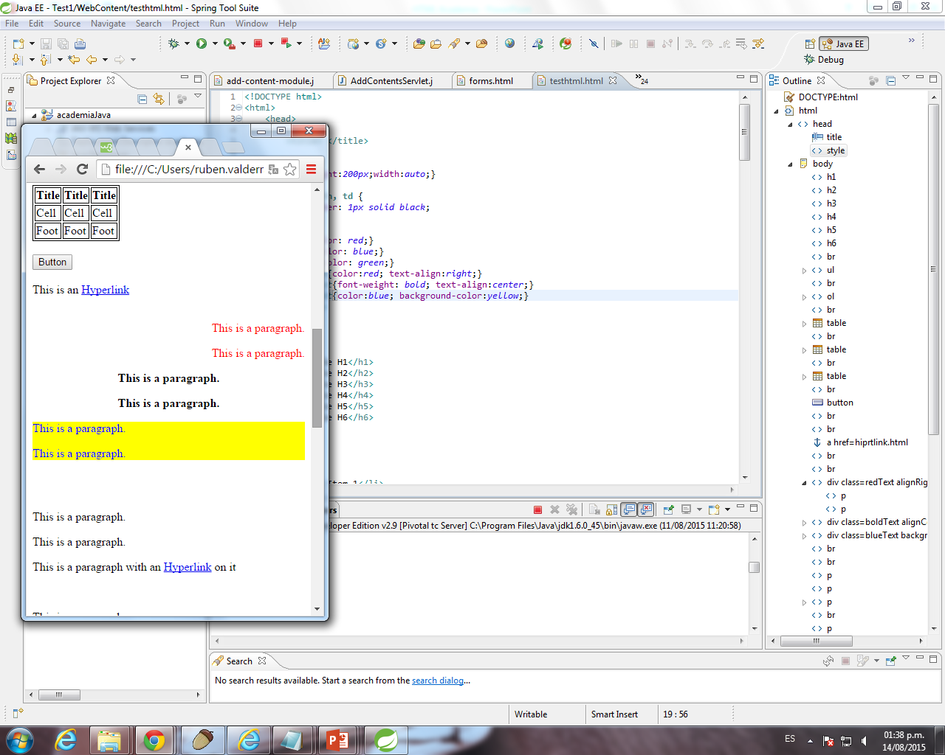
DIVS
<div> Short for "division," <div> allows you to divide your page into containers . Is one of the most versatile structure tags available.
Use to group elements together and apply CSS styles all at once.

Slide 17
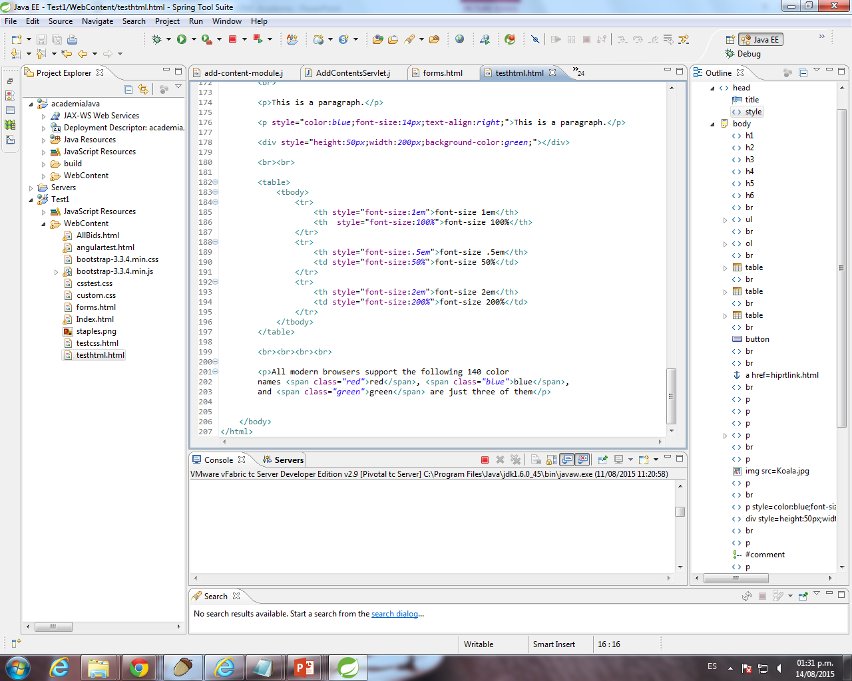
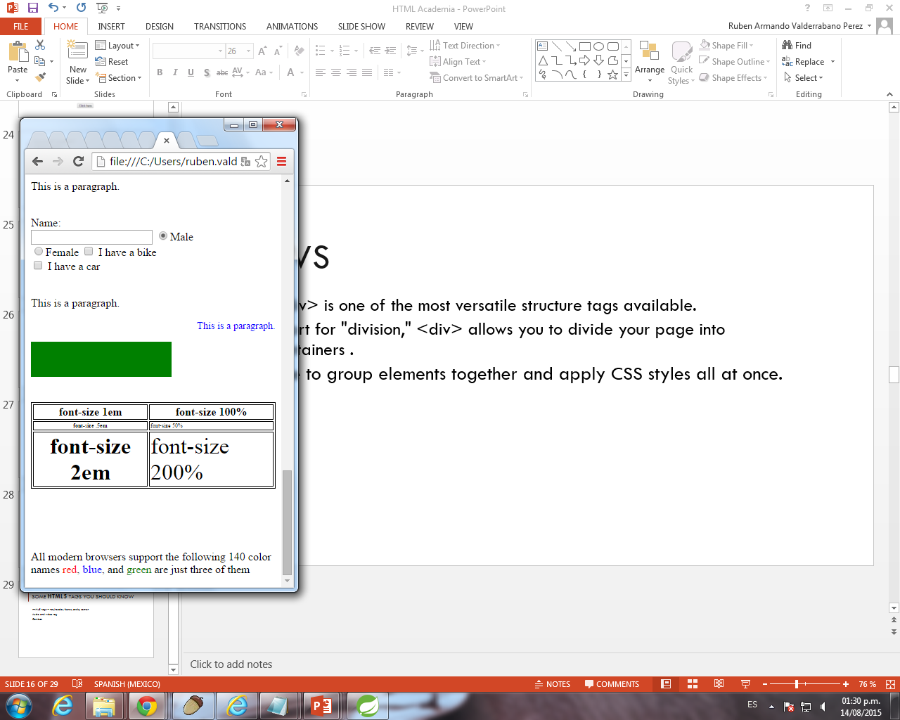
SPANS
<span> allows you to control styling for smaller parts of your page, such as text.

Slide 18
FORMs
HTML Forms are one of the main points of interaction between a user and a web site or application.
They allow users to send data to the web site. Most of the time that data is sent to the web server, but the web page can also intercept it to use it on its own.
An <Form> is made of one or more widgets. Those widgets can be text fields, select boxes, buttons, checkboxes, or radio buttons.

Slide 19
The HTML <form> tag is used to create an HTML form and it has following syntax:
The action attibute defines the location (an URL) where the form's collected data should be sent (form-handler).
The method attribute defines which HTTP method to send the data with (it can be "get" or "post").
<form action="Script URL" method="GET|POST">
form elements like input, textarea etc.
</form>

Slide 20
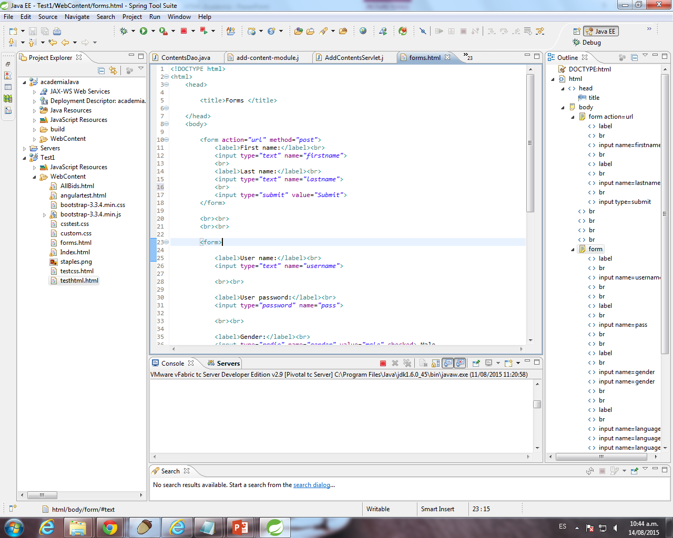
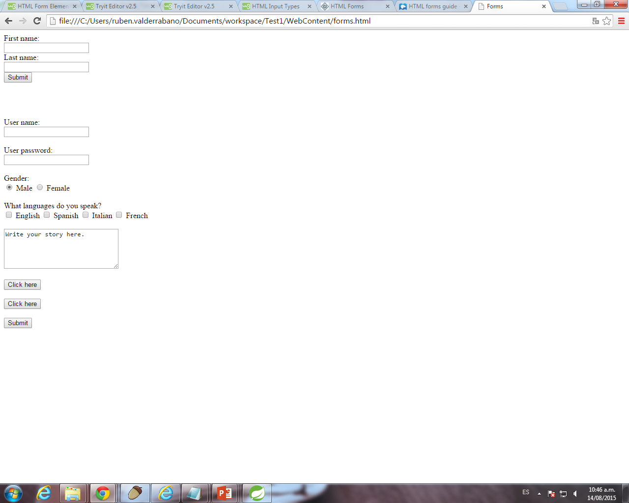
Form Example
<label> that describes their purpose of the element.

Slide 21
<Input>
The input element is used to create interactive controls for forms.
This control is used for items that require only one line of user input, such as search boxes or names.
This element can vary in many ways, depending on the type attribute.

Slide 22
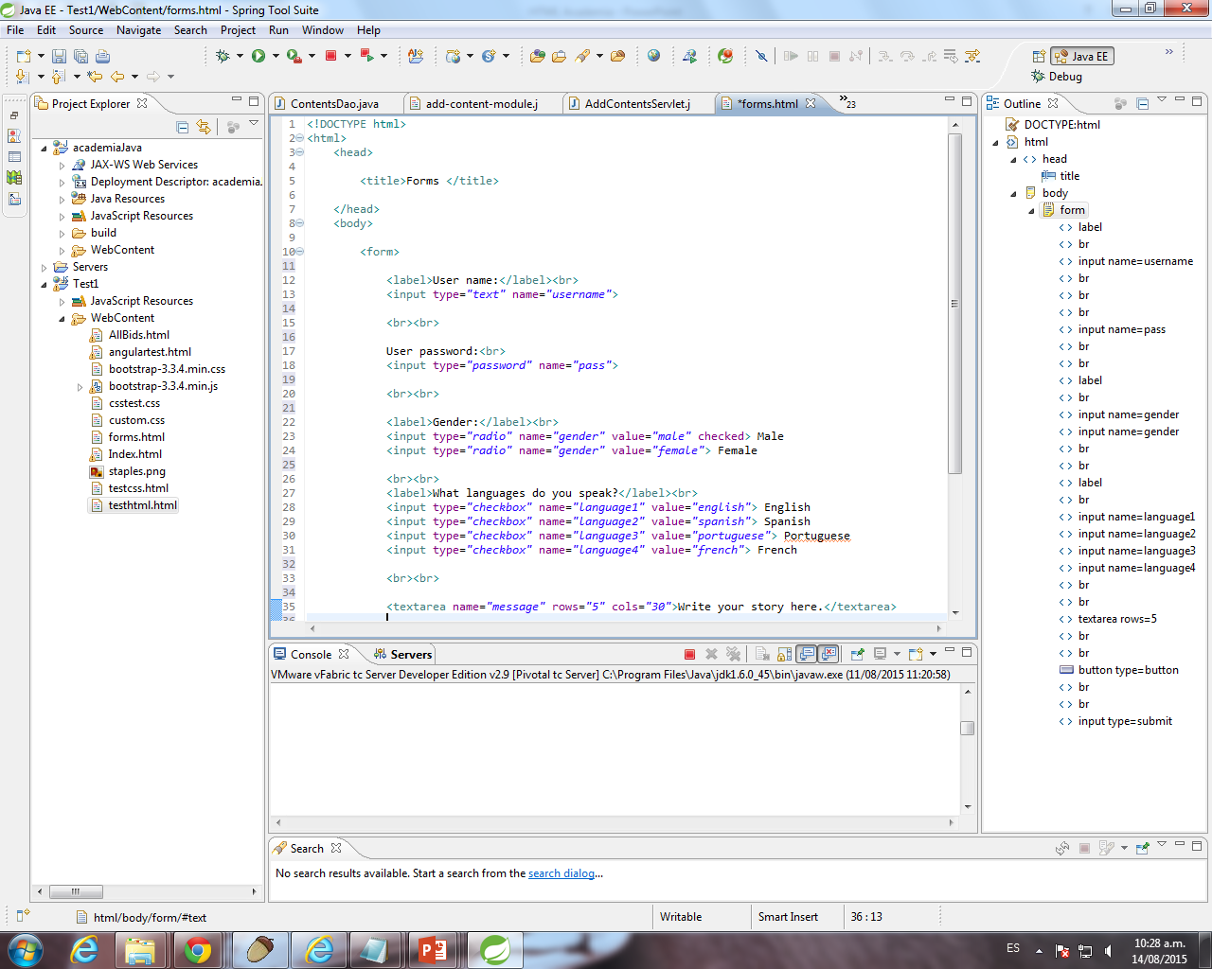
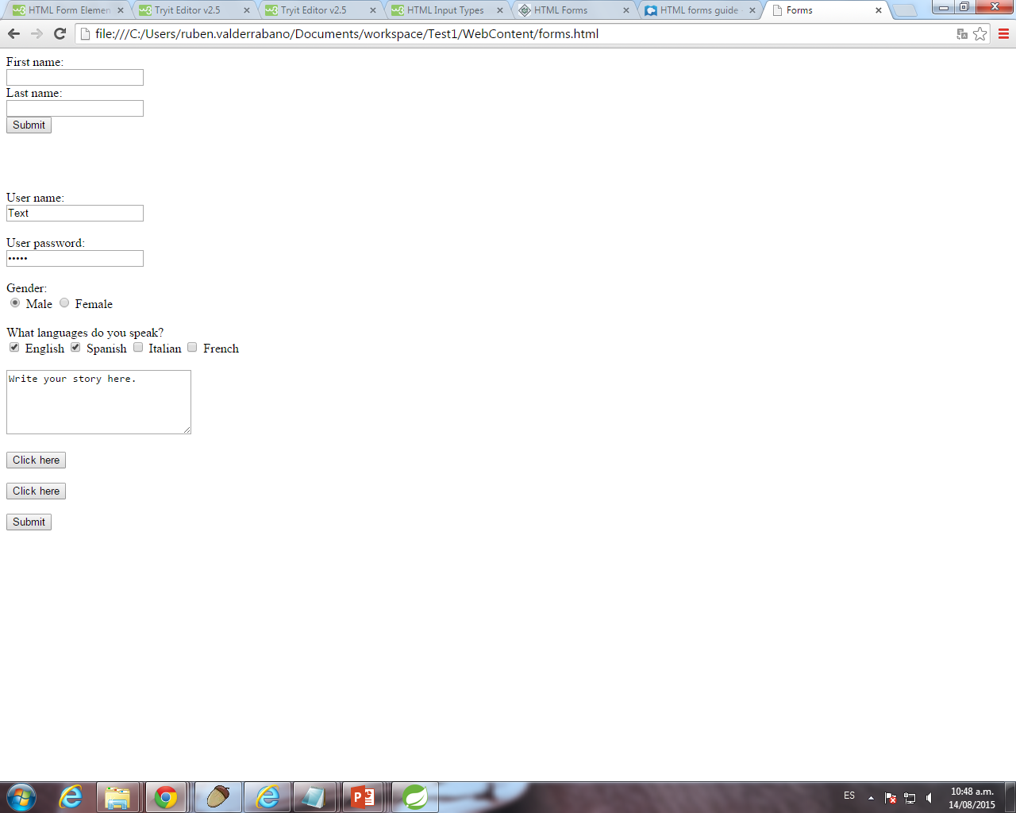
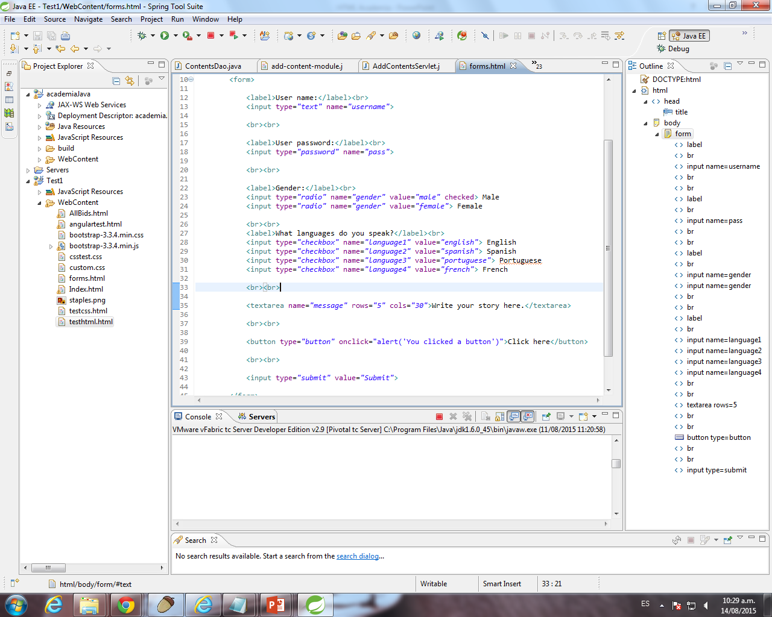
<input type="text">
Defines a one-line input field for text input.
<input type="password">
Defines a password field.

Slide 23
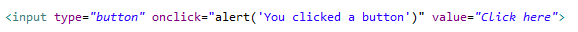
<input type="submit">
Defines a button for submitting form input to a form-handler.
<input type="button">
Defines a button:

Slide 24
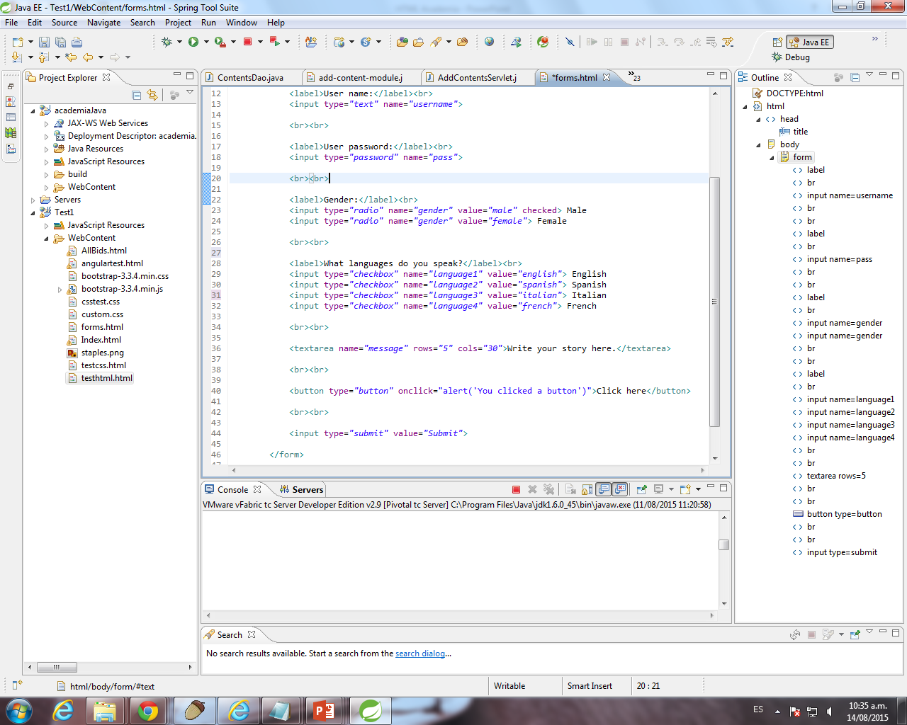
<input type="checkbox">
Defines a checkbox.
Checkboxes let a user select zero or more options of a limited number of choices.

Slide 25

<input type="radio">
Defines a radio button.
Radio buttons let a user select only one of a limited number of choices.

Slide 26
HTML5 Imputs
HTML5 introduces 13 new input types for forms.
These new input types have dual benefits: using them means less development time and an improved user experience.
color
date
datetime
datetime-local
email
month
number
range
search
tel
time
url
week

Slide 27
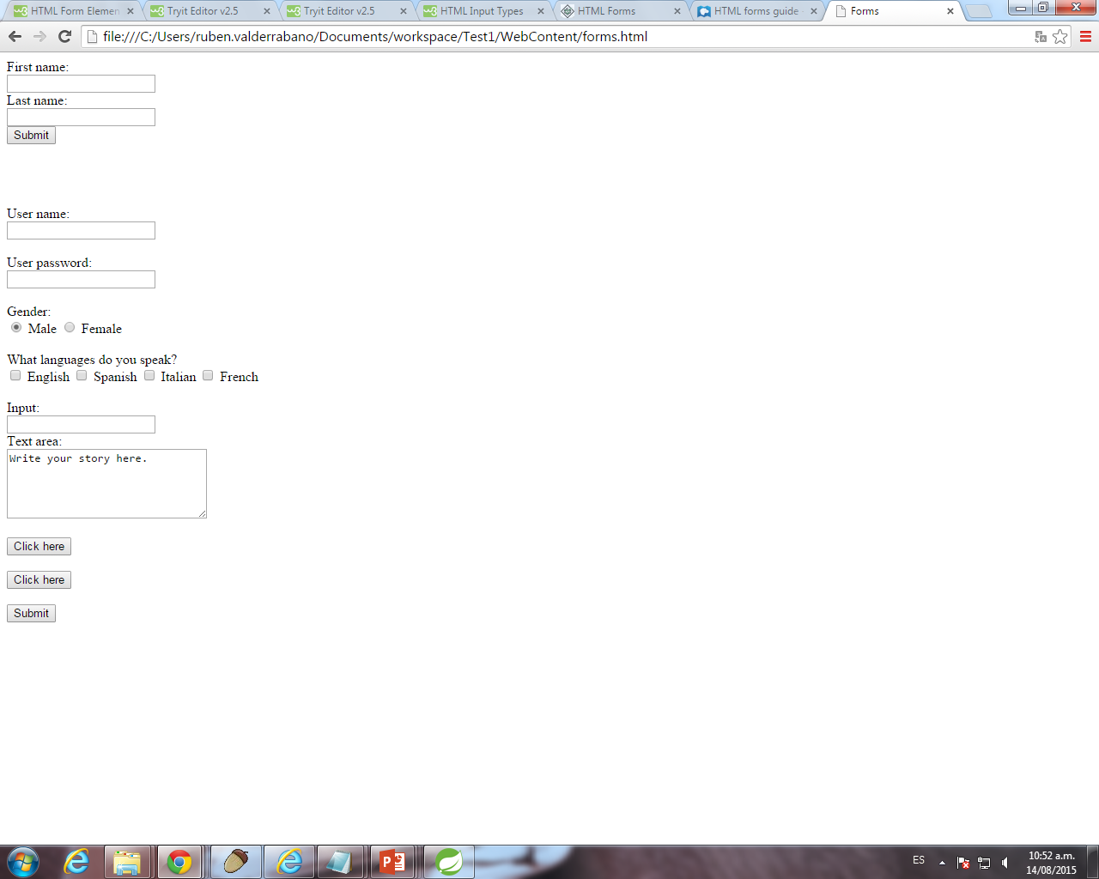
<textarea>
The textarea element represents a multi-line plain-text editing control.
This is used when the user is required to give details that may be longer than a single sentence.

Slide 28

<button>
The button element represents a clickable button.

Slide 29
Some HTML5 tags you should know
HTML5 tags – nav,header, footer, aside, section
Audio and video tag
Canvas

